Slide 1






Web Fundamentals (HTML and CSS)
Course Overview
HTML & CSS
SoftUni Team
Technical Trainers
Software University
http://softuni.bg

Slide 2





Table of Contents

Slide 3
Have a Question?
sli.do #front-end

Slide 4







SoftUni Diamond Partners

Slide 5

Front-End Development @ SoftUni
3 Months Web Front-End Training

Slide 6
Web Basics: Module Goals
3 months intensive front-end
4 times weekly, lots of live coding and exercises
Part I – Web Fundamentals (HTML + CSS)
HTML, document structure, CSS, selectors, rules, presentation and positioning, landing pages, forms, responsive design, transitions, animations, practical exam
Part II – JavaScript for Front-End
Bootstrap, CSS Preprocessors, Arrays, Objects, Maps, Sets, JSON, JQuery, DOM, Events, Ajax, Requests, HTTP, practical exam

Slide 7
Web Basics Module at SoftUni – Timeline
19-Sept-2017
31-Oct-2017
January-2018
Web Fundamentals (HTML & CSS)
Lessons + exercises + team work + exam
6 weeks * 4 times / week
6 credits
Start: 19-September-2017
Final exam: 29-October-2017
JavaScript for Front-End
Lessons + exercises + team work + exam
5 weeks * 4 times / week
6 credits
Start: 31-October-2017
Final Exam: 03-December-2017
Front-End Re-Take Exams
First week of January 2018

Slide 8
Professions @ SoftUni
Programming Basics
Java
Fund.
Java
DB
Java
Web
JS Core
Front-End
Tech Module
C#
Fund.
C#
DB
C#
Web
JS Core
Front-End
Programming Fundamentals
JS Core
JS
Web
Front-End
Software Technologies
PHP
Web
Front-End
JS Core
https://softuni.bg/curriculum
https://softuni.bg/trainings/courses

Slide 9

Web Fundamentals (HTML + CSS)
Course Objectives & Program

Slide 10
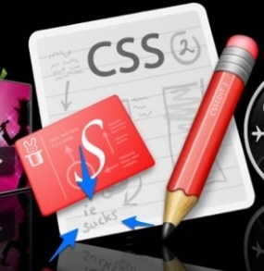

Web Fundamentals – Course Topics
HTML and CSS Overview – HTML basic tags, basic CSS, creating simple Web pages
HTML Structure – structural tags, header, footer, main, aside, tables, multimedia and other tags
Introduction to CSS – basic CSS styling, CSS rules, selectors, pseudo-selectors, declaration, values…
CSS in Depth – Types, Values, Ranges…
CSS Formatting and Positioning - styling text borders, backgrounds, size, margins, positioning…

Slide 11


Web Fundamentals – Course Topics (2)
Creating Landing Pages
HTML Forms and Styling – HTML controls, styling HTML forms
Responsive Design – media queries, flex grid, flexible images, fonts, tables, menus...
Transitions and Animations – HTML5 transitions, HTML5 animations
Exam Preparation
Teamwork Public Defenses
Practical Exam

Slide 12

The Trainers Team

Slide 13

Trainers Team
Ivaylo Dimitrov
4+ years experience in the IT (HTML, CSS, JavaScript, C#, SQL,
Windows Server)
Student with excellent grades in Software University
Technical Trainer in Software University

Slide 14

Trainers Team
Georgi Genov
Started as a Freelance Web Developer.
Currently a Team Leader of a PHP Team
Various personal projects
Strong skills in PHP, HTML & CSS, JavaScript, SASS, LESS…
Personal Blog: www.ggenov.eu

Slide 15

Web Fundamentals: More Details
Duration, Languages, Technologies

Slide 16


Training Duration – Web Fundamentals
Lessons: ~ 50 hours (onsite + YouTube videos)
Practical exercises (in class): ~ 60 hours
Homework: ~ 30 hours
Exam preparation: 8 hours
Exam: 6 hours
Schedule: 19 September – 29 October 2017
Exam date: 29 October 2017

Slide 17

Why HTML & CSS?
HTML & CSS – standard for Web UI
Web-based applications are very popular
Runs on any device with a Web browser
HTML5 is currently the #1 job trend based on the fastest growing keywords found in online job postings
HTML5 takes bigger chunk of the mobile application market
Every IT professional should know HTML & CSS

Slide 18



Why English?
Why the slides are in English?
English is the native language of the software engineers
Specific terminology should be in English
Translations are inaccurate and funny
Just learn English!
No excuses

Slide 19



Learn to Search in Internet & Find Solutions!
The course assignments require to search in Internet
This is an important part of the learning process
Some exercises intentionally have no hints
Learn to find solutions!
Software development includes everyday searching and learning
No excuses, just learn to study!
Developers learn new technologies, tools, languages every day!

Slide 20

Evaluation

Slide 21


Scoring System for the Course
Mandatory:
Final exam – 90%
Homework submissions – 10%
Bonuses:
Teamwork – 10% bonus
Presence in class – 5% bonus
Forum activity – bonus up to 5%

Slide 22
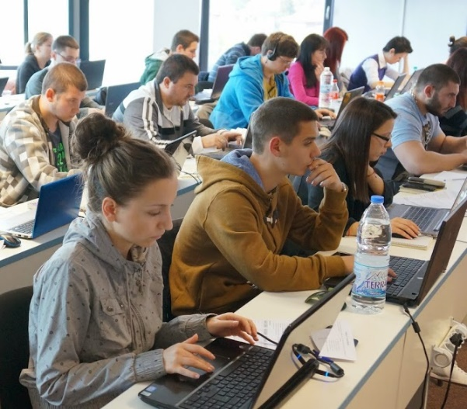

Web Fundamentals Exam
Practical HTML & CSS exam
4 practical problems for 6 hours
Slice a screenshot to HTML + CSS
Implement an HTML form (from screenshot to HTML + CSS)
Create a simple Web site from screenshot (header + menu + sidebar + footer)
Make a Web site responsive

Slide 23
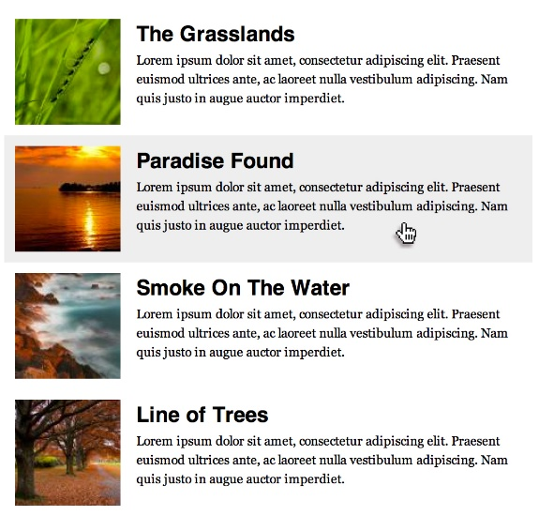


Sample Exam Problem
You are given a screenshot + set of images + texts
You should create the HTML & CSS to implement the page at the screenshot
+

Slide 24

Homework Assignments
Doing your homework is very important!
HTML and CSS can only be learned through a lot of practice!
You should write code every day!
Each lesson is followed by a few exercises
Try to solve them in class
The rest are your homework
Homework assignments are due in 6 days after each lesson
Submission are accepted through: judge.softuni.bg

Slide 25










Resources
What We Need Additionally?

Slide 26



Web Fund. Course Web Site, Forum and FB Group
Official web site:
Official discussion forum:
Official Facebook groups:
https://softuni.bg/courses/web-fundamentals
https://softuni.bg/forum/categories/68/web-basics
https://www.facebook.com/groups/front.end.sept.2017/

Slide 27

The Front-End Development Slides and Videos
All lecture slides, videos, homework assignments, projects and other resources are open content, available for free
Visit the course web site to access the course resources

Slide 28

HTML & CSS Tutorials
W3School HTML Tutorial
http://www.w3schools.com/html/
Learn to Code HTML & CSS
http://learn.shayhowe.com/html-css/
CSS Tricks
http://css-tricks.com
Codecademy HTML & CSS Interactive Tutorials
https://www.codecademy.com/learn/learn-html-css

Slide 29

Software University Learning System (SULS)
Software University Learning System (SULS)
www.softuni.bg
Important resource for students
Homework submissions
Homework check-up
Exams and results
Reports about your progress
…

Slide 30








Recommended Software
You will need a good text editor, e.g.
Notepad++
You may try many HTML authoring tools like:
WebStorm
Visual Studio Code
Sublime Text / Atom / Brackets
Microsoft Visual Studio
Netbeans

Slide 31


Summary
The "Web Fundamentals" course teaches
The first steps in HTML & CSS
Training curriculum
HTML, tags, tables, forms, semantic HTML, CSS, styles, positioning, layout, responsive
Practical exam
4 practical problems for 6 hours
Learning resources
Slides, videos, software, books, forum
HTML & CSS

Slide 32
PHP Web Development Basics – Course Overview
softuni.bg/courses/web-fundamentals

Slide 33
License
This course (slides, examples, demos, videos, homework, etc.) is licensed under the "Creative Commons Attribution-NonCommercial-ShareAlike 4.0 International" license

Slide 34





Trainings @ Software University (SoftUni)
Software University – High-Quality Education, Profession and Job for Software Developers
softuni.bg
Software University Foundation
http://softuni.foundation/
Software University @ Facebook
facebook.com/SoftwareUniversity
Software University Forums
forum.softuni.bg

